Slide 1

Classifying the coffee quality with the Aroma of Machine learning models
SAI SRUJANA JAKKALA
ADVISOR: PROF.ITAUMA

Slide 2





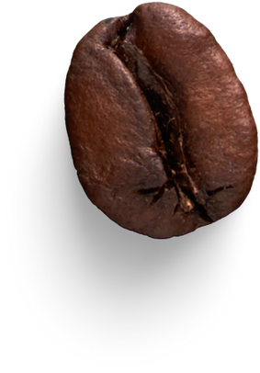
Objectives
The project aim is to use data driven machine learning models to classify the quality of the coffee into distinct groups that help the coffee producers focus on important factors that influence the quality.
Improve the production and marketers to segment the product as premium, quality and regular.
Producing and testing the coffee bean at various level for achieving consistent quality is a challenge to the exporters.
By understanding the influence of various evaluation factors and its relations helps coffee industry produce better quality bean and take better decisions on production, cultivation, processing, marketing and quality assessment to serve best quality coffee to the consumer market and gain good market share.

Slide 3



Agenda
1
Introduction, Process
2
Data and EDA analysis
3
Pre-processing and model building
4
Model evaluation and optimization
Good ideas start with brainstorming, but Great ideas start with a cup of Coffee
5
Choice of model and metrics
6
Implementation, challenges and recommendations
7
Future scope for project

Slide 4


The Coffee Production Process
ML
Cultivation
Harvesting
Processing
Growing coffee plants
Picking coffee cherries
Removing beans from cherries
ML
Roasting
Grinding & Brewing
Enhancing flavor
Grinding & Brewing

Slide 5
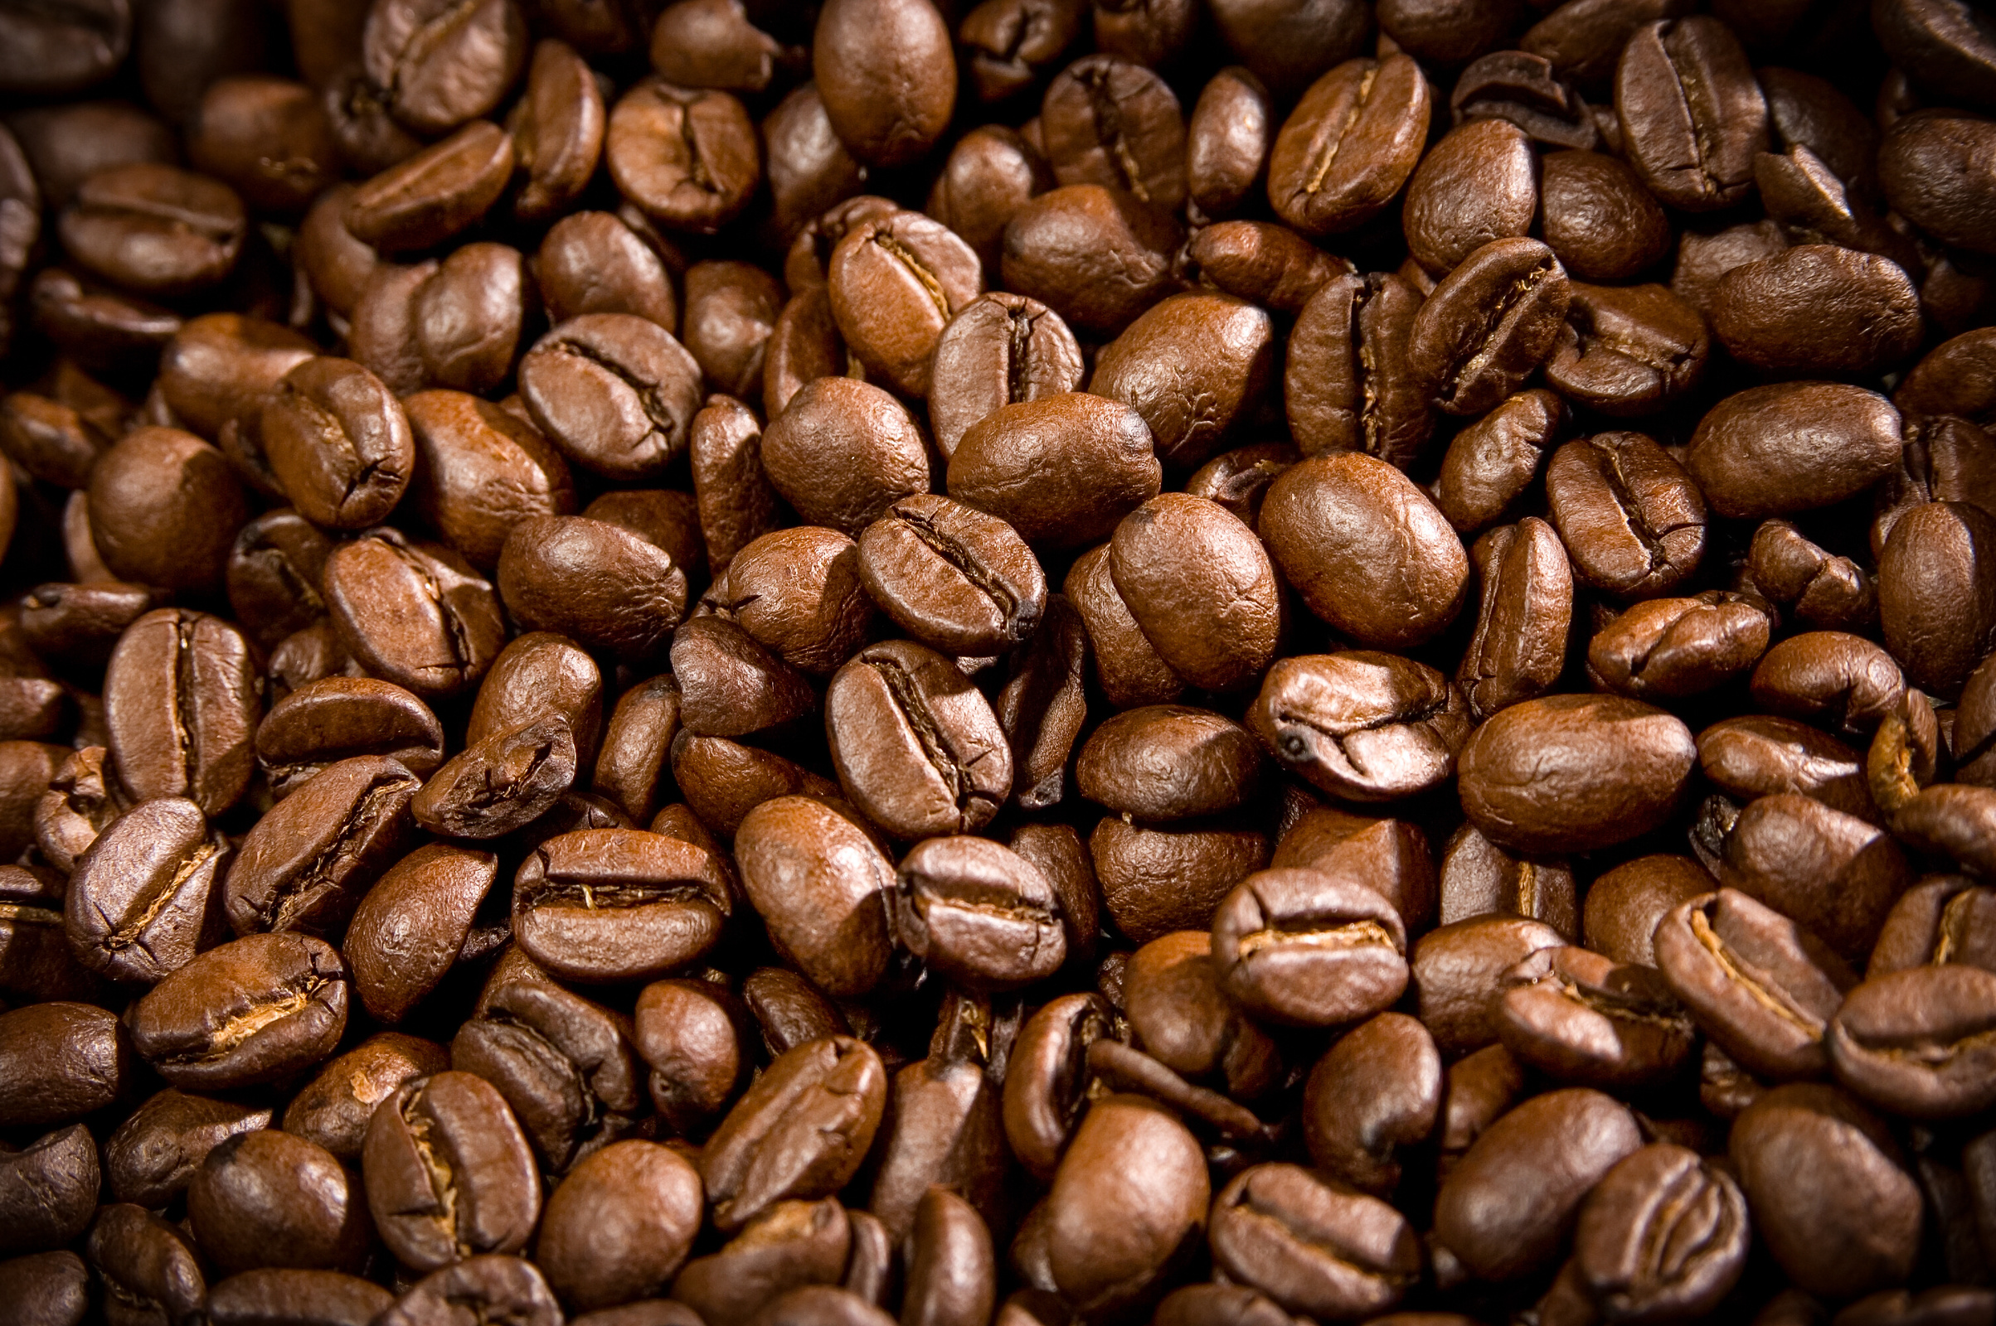

Data Variables
1
Coffee characteristics (Species, Variety, Processing Method)
2
Origin information (Country, Farm, Region)
Arabica
Smooth flavor, lower caffeine, grown at higher altitudes
3
Quality scores (Aroma, Flavor, Aftertaste, etc.)
4
Production details (Number of Bags, Harvest Year)
5
Altitude information
Robusta
Strong, bitter, higher caffeine, grown in low altitudes
6
Certification information

Slide 6

01
GAS CHROMATOGRAPHY-MASS SPECTROMETRY (GC-MS).
Literature Review
J.S. RIBEIRO A, F. AUGUSTO B, T.J.G. SALVA C, M.M.C. FERREIRA. TALANTA VOLUME 101, 15 NOVEMBER 2012, PAGES 253-260. PREDICTION MODELS FOR ARABICA COFFEE BEVERAGE QUALITY BASED ON AROMA ANALYSES AND CHEMOMETRICS. HTTPS://WWW.SCIENCEDIRECT.COM/SCIENCE/ARTICLE/PII/S0039914012007783
02
Means of Association Rule Mining
DANIELE APILETTI, ELIANA PASTOR. DEPARTMENT OF CONTROL AND COMPUTER ENGINEERING, POLITECNICO DI TORINO, CORSO DUCA DEGLI ABRUZZI 24, 10129 TORINO, ITALY. CORRELATING ESPRESSO QUALITY WITH COFFEE-MACHINE PARAMETERS BY MEANS OF ASSOCIATION RULE MINING. HTTPS://WWW.MDPI.COM/2079-9292/9/1/100
03
Quality control and process monitoring
Hebatullah H. Farghal, Somaia T. Mansour, Sondos Khattab, Chao Zhao, Mohamed A. Farag. Food Chemistry, Volume 394, 15 November 2022, 133529. A comprehensive insight on modern green analyses for quality control determination and processing monitoring in coffee and cocoa seeds. https://www.sciencedirect.com/science/article/abs/pii/S0308814622014911

Slide 7

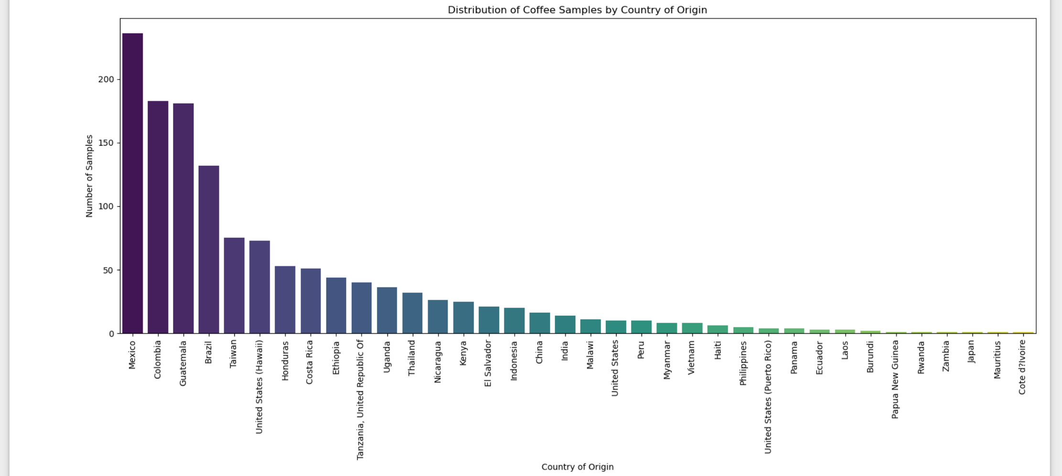
EDA - Coffee growing countries
Mexico is the highest producing country.
Country.of.Origin:
Mexico 236
Colombia 183
Guatemala 181
Brazil 132
Expectation vs Reality:
Expected either Ethiopia or brazil to be the top producers but Mexico turned out to be the highest producer according to dataset

Slide 8


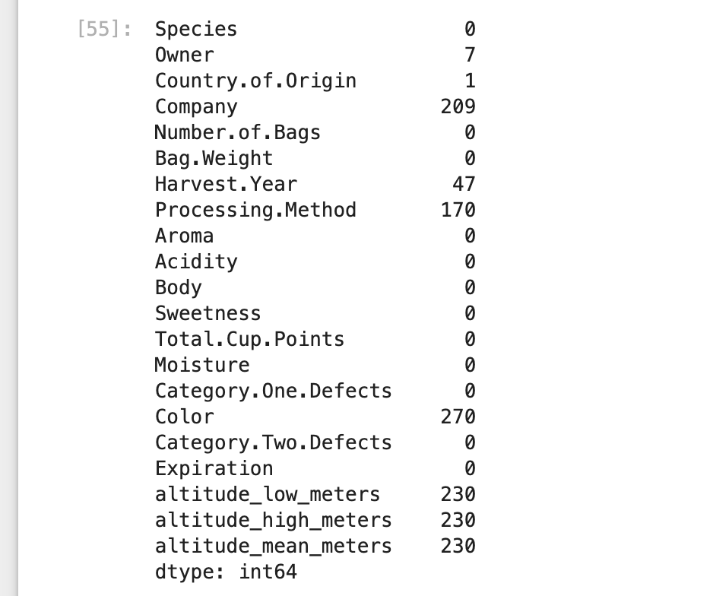
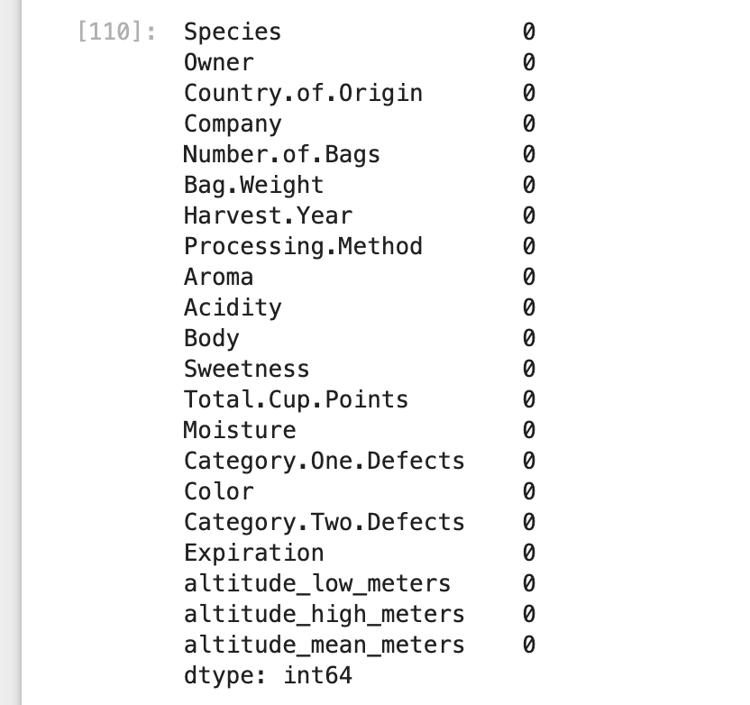
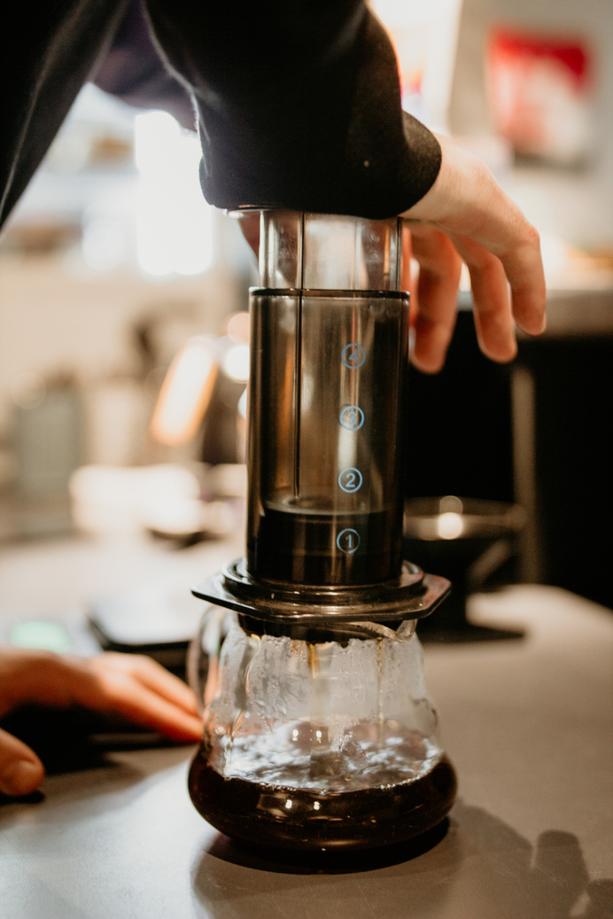
Data Treatment
The dataset contains total of about 43 variables and we will choose to drop the unnecessary variables for the analysis to make it simpler
Replace the missing values with the majority for categorical column and mode value for the numerical column
01
02
Before replacing
After replacing

Slide 9


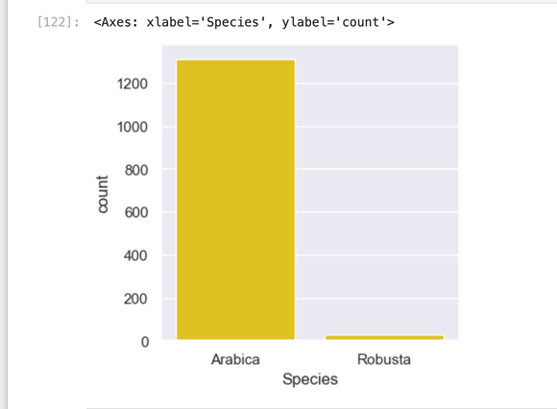
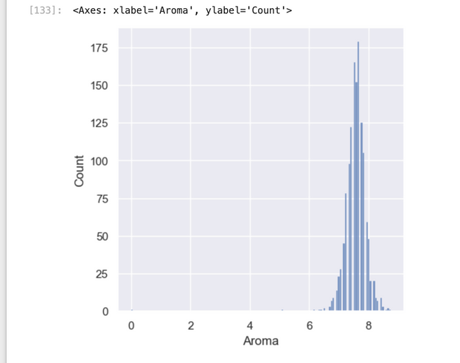
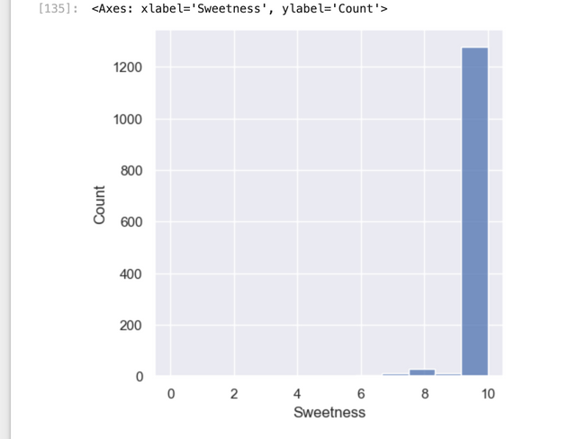
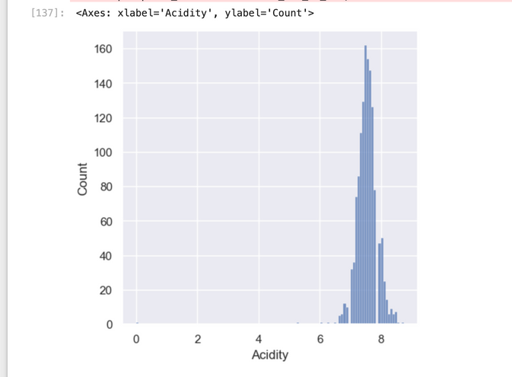
Visualization
Distribution Types
Aroma
Sweetness
Acidity
Arabica data is more in the dataset
Most of the data is concentrated between 6 and 9, indicating a strong central tendency in this range.
The distribution appears to be right-skewed ie higher aroma values are less common.
The peak, or mode, is near the middle of the range, indicating the most frequent aroma values.
There is a significant spike at the maximum value of around 10, indicating that most of the data points have high sweetness.
Most of the data is concentrated between 7 and 8, indicating a strong central tendency in this range.

Slide 10
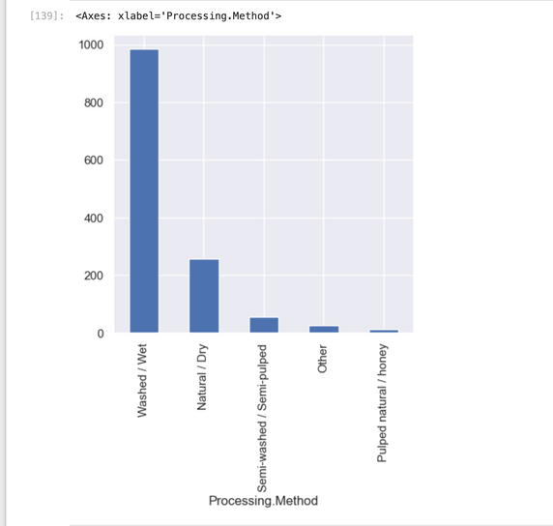
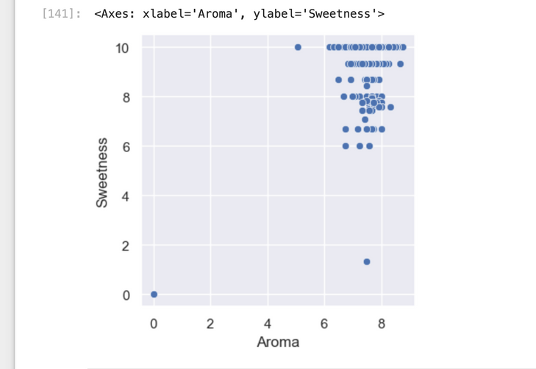
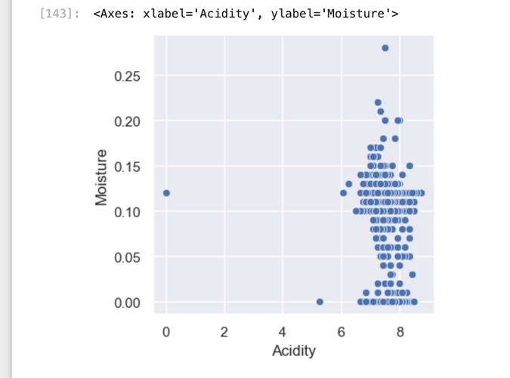
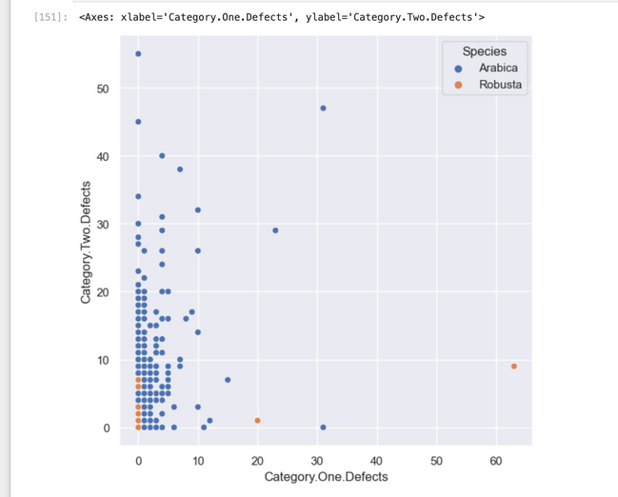
Visualization
Processing Methods
Aroma vs Sweetness
Moisture vs Sweetness
Category 0ne defects vs Category two defects
Washed and wet processing method is most common in the dataset
Aroma values range from 0 to 10, while sweetness values also span a similar range.
Most clusters between 6 to 9.
Majority data does not show strong correlation.
Acidity values range from 0 to 9, while moisture values range from approximately 0 to 0.3.
There is a cluster of data points generally between acidity levels of 5 and 9.
Moisture shows variation but tends to concentrate between 0.05 and 0.15.
No strong correlation
(Category.One.Defects) ranges from 0 t0 60.
(Category.Two.Defects) has values mostly between 0 and 15.
The majority of the data represent "Arabica" (indicated by blue circles),
There is a noticeable clustering of "Arabica" points, particularly where Category.One.Defects values are lower (0 to 15).

Slide 11
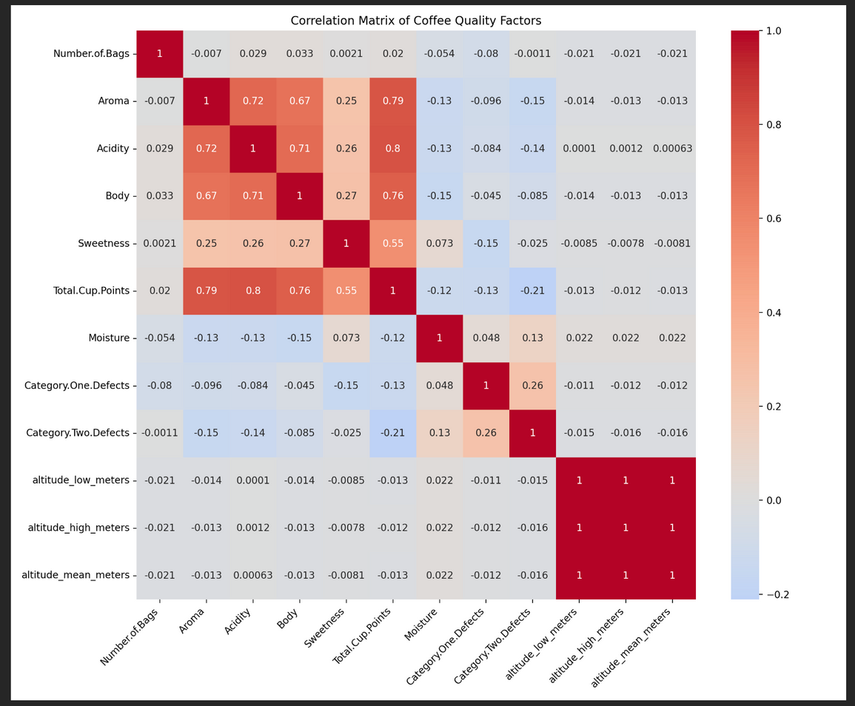
Correlation Matrix
Total Cup Quality is the target variable
Strong positive correlations:
Aroma (0.86)
Acidity (0.84)
Body (0.82)
Other relationships:
Altitude (low, high, and mean) shows a weak positive correlation with quality scores
Moisture content and defects (Category One and Two) show very weak negative correlations with quality scores
Sweetness shows relatively lower correlation with other factors, likely because it has less variation in the dataset

Slide 12
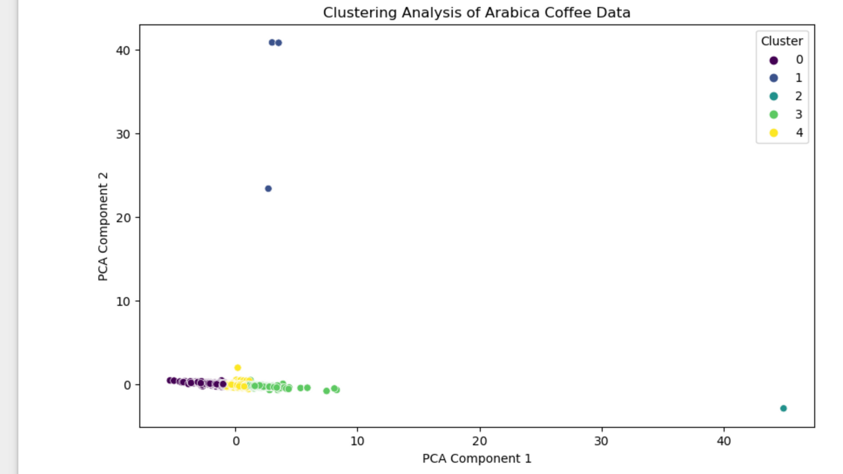
Clustering Analysis
Performed:
Feature scaling and normalization technique.
Dimensionality Reduction (PCA)
K-Means clustering with N=3 initially
Performed Elbow method for optimal K value
Increased the n to 5 clusters
Findings:
Silhouette Score for KMeans clustering: 0.1249
Indicates some overlap between clusters and suggests further tuning.

Slide 13
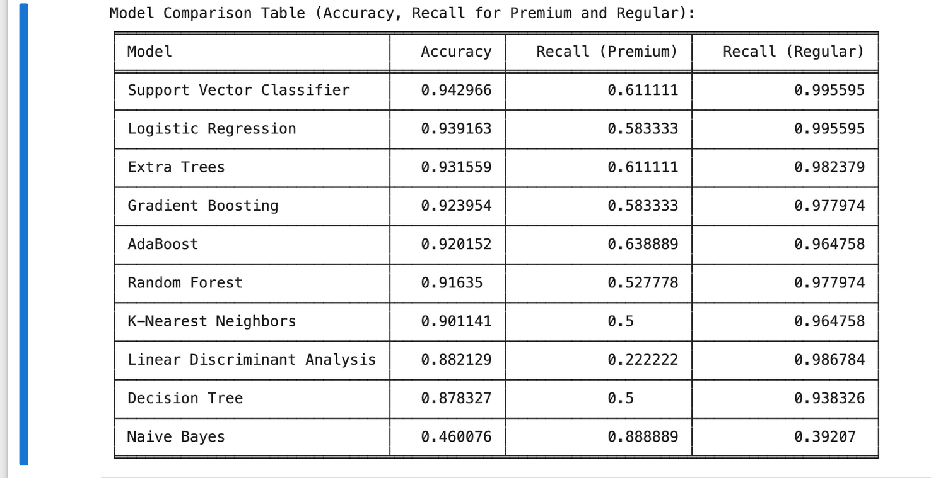
Classification report
Total Cup Quality is the target variable
Classifying the data into groups based on Q-score from Coffee quality institute
Premium: > 80
Regular: <=80
Findings:
The SVM is the best model with accuracy of about 94%
Logestic regression and Extra trees classifier are equally good with about 94% and 93% respectively.
The data could classify more accurately for regular coffee as distribution is more.
Comparison of models

Slide 14
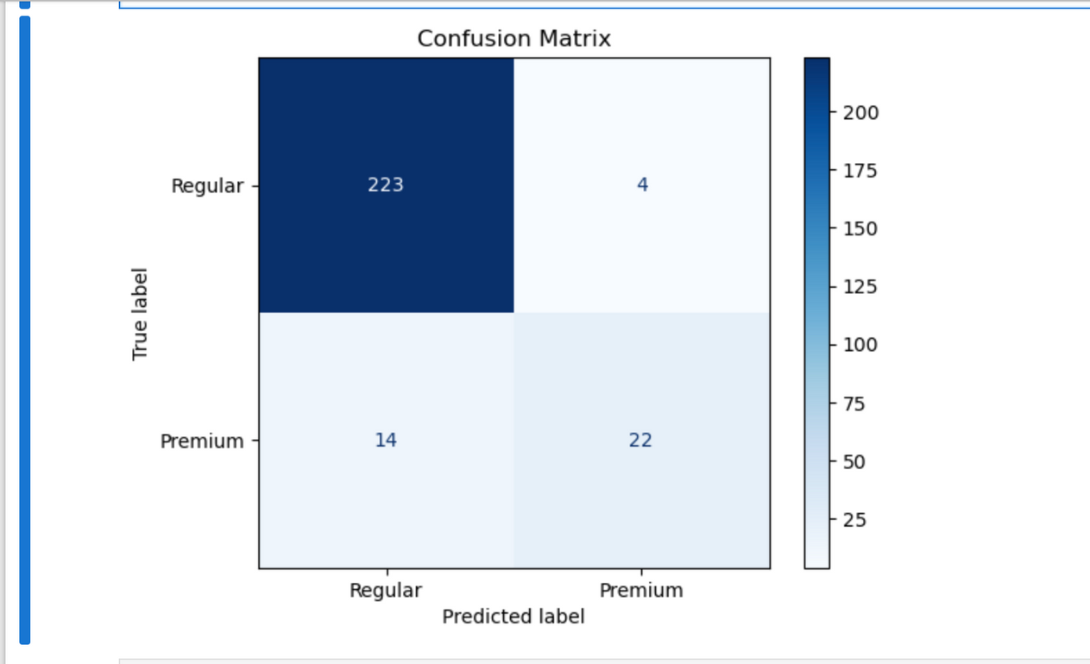
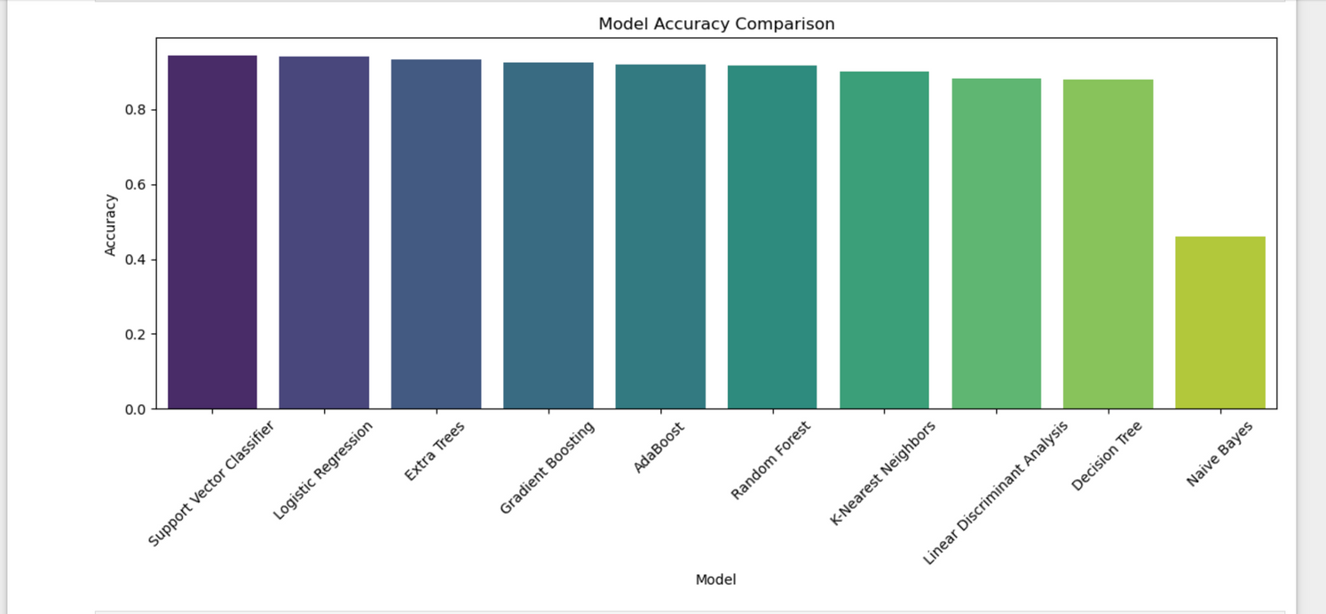
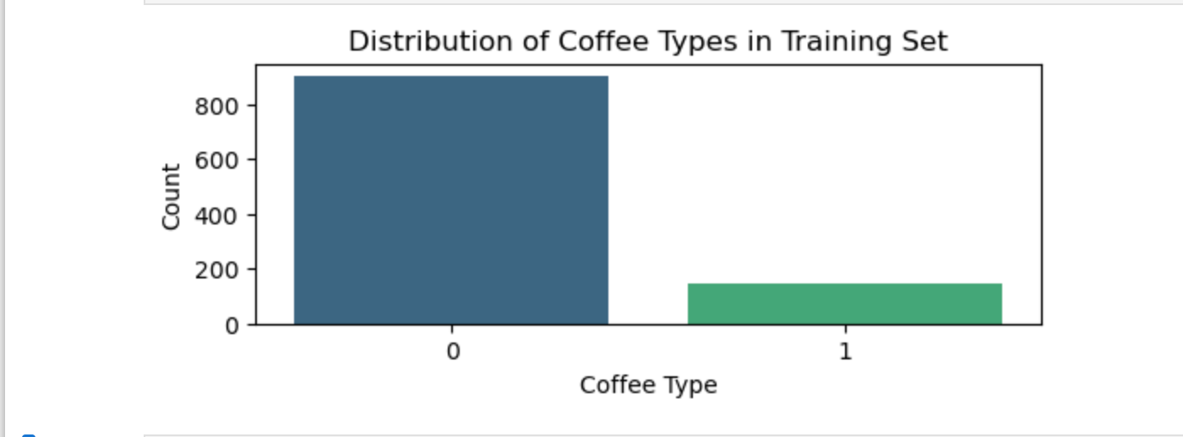
Classification report

Slide 15
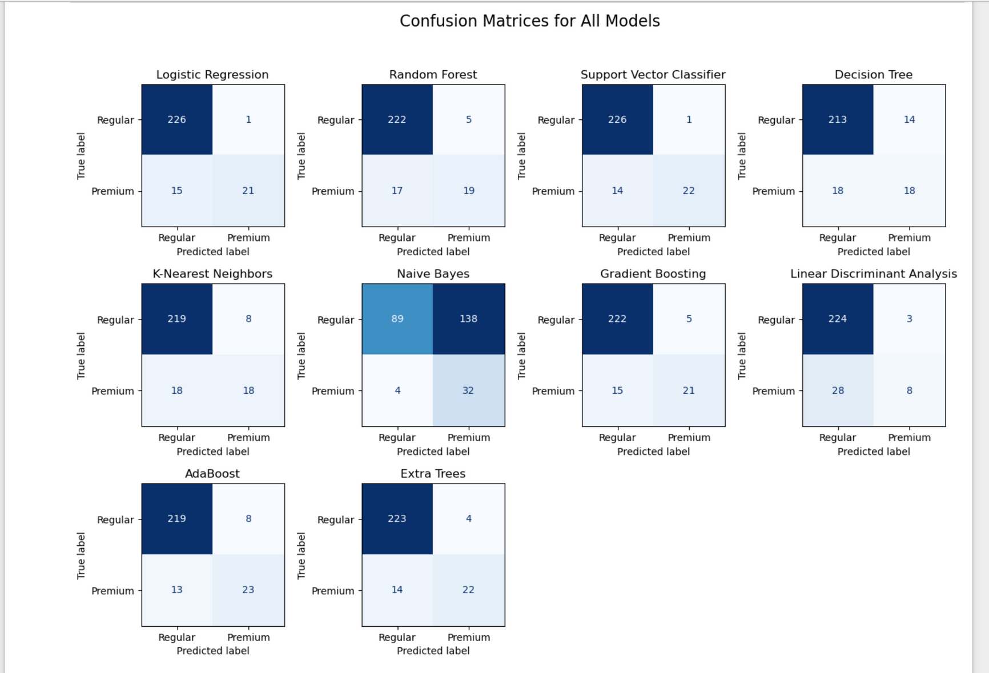
Classification Report

Slide 16
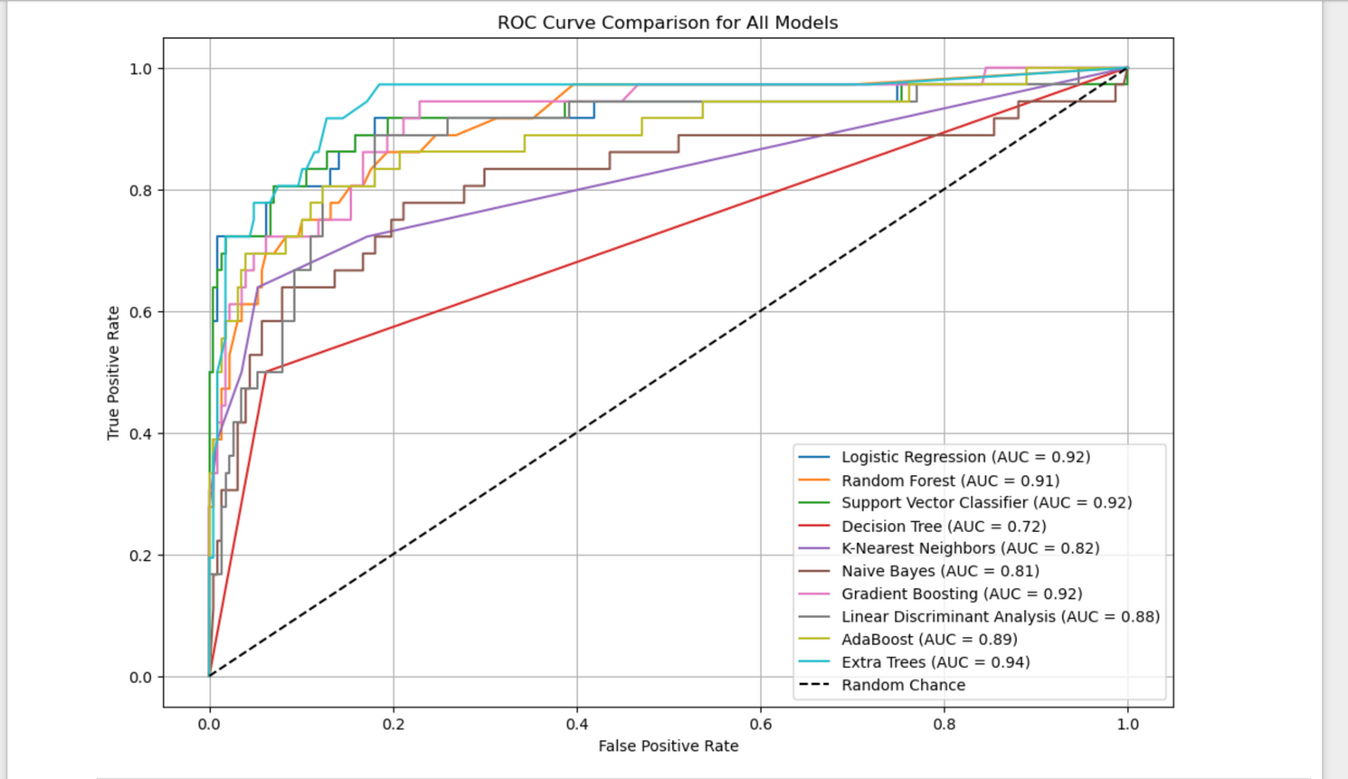
AUC-ROC Curve
AUC (Area Under the Curve):
AUC-ROC curve is a single scalar value between 0 and 1.
AUC Interpretation:
AUC = 1: Perfect classifier (no false positives or false negatives).
AUC = 0.5: The model is no better than random guessing.
AUC < 0.5: The model is performing worse than random guessing
AUC-ROC graph interpretation:
AUC-ROC explains how well a classifier can distinguish between the positive and negative classes.
It evaluates the model across all possible thresholds for classification and shows its ability to discriminate between classes.
Higher AUC indicates that the model is better at distinguishing between classes, even with changing decision thresholds.
Model comparison

Slide 17
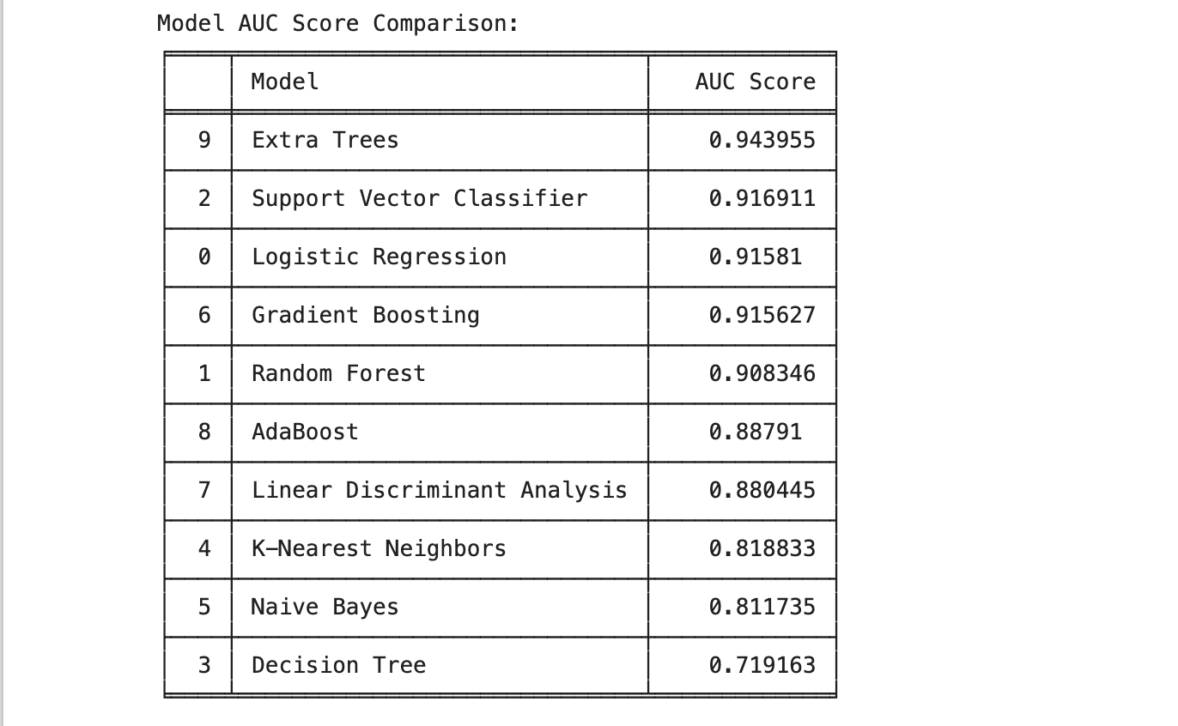
AUC-ROC Curve
AUC-ROC better than Accuracy metrics?
Accuracy is simply the percentage of correct predictions made by the model. It can be misleading, especially when there is an imbalanced dataset (e.g., when one class is much more frequent than the other)​
Comparison of AUC-ROC curve value and accuracy value:
Support Vector Classifier (SVC) have high accuracy because it focuses on finding the optimal hyperplane that separates the classes but many not distinguish between the classes perfectly.
But here Extra trees model has AUC ROC can provide more insight by evaluating the model's performance across various thresholds, not just a fixed classification boundary.
AUC-ROC is particularly useful when the classes are imbalanced or optimize for a particular trade-off between false positives and false negatives.
SVC and logistic regression also have good AUC-ROC.
Model comparison

Slide 18

Which is better metrics?
Imbalanced Data:
AUC-ROC remains a better metric as it takes both classes into account, highlighting how well the model distinguishes between them.
Threshold Sensitivity:
AUC-ROC evaluates performance across all thresholds, offering a better overall picture of model performance.
Threshold Flexibility:
The ROC curve helps you explore how the model performs with different thresholds (e.g., adjusting for higher recall or precision).
Findings:
AUC-ROC explains how well the model can distinguish between classes, independent of the threshold, while accuracy tells you the % of overall correct predictions at a fixed threshold.
AUC-ROC is better at revealing this when the dataset is imbalanced or when you need to evaluate the model's behavior across different decision thresholds.

Slide 19



Model Evaluation overview
Classification analysis:
SVM is the best model with about 94% accuracy but cannot classify distinct classes well
Classification analysis: AUC-ROC curve metrics
Extra trees model has AUC ROC accuracy of 94% and evalutes better.
Clustering analysis:
Silhouette Score for KMeans clustering: 0.1249

Slide 20

Implementations
Automation of coffee classification
Continuous Monitoring of batch processing
Speed and efficiency in processing
Predictive insights for improving quality
Continuous feedback and advanced quality control methods
Threshold flexiblity
Scalability and deployment

Slide 21
Challenges
Data Quality
Data imbalance and bias
Data availability
Model Drift
Real time latency in processing
Interpretation of models
Recommendations
ML models for real time coffee classification
AUC-ROC help ensure that the models can distinguish well between different coffee types.
Make sure that the system is equipped to handle data in a continuous, automated manner with minimal latency. Regular model updates and monitoring will be required.
Adaptive system improve the quality of grading and processing of coffee batches.

Slide 22
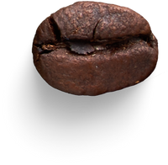

Future Scope
Automation and ML in agricultural production
Large language models
More distinction of groups
Other advanced techniques

Slide 23
Thank You.

